Slide 1
VISUAL REASONING
DICE
(EXERCISE-A)

Slide 2
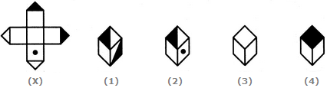
VISUAL REASONING
DICE (EXERCISE-A)
Q 1. Choose the box that is similar to the box formed from the given sheet of paper (X).
A. 1 and 2 only B. 2 and 4 only
C.2 and 3 only D. 1 and 4 only

Slide 3
VISUAL REASONING
DICE (EXERCISE-A)
Q 1. Choose the box that is similar to the box formed from the given sheet of paper (X).
A. 1 and 2 only B. 2 and 4 only
C.2 and 3 only D. 1 and 4 only

Slide 4
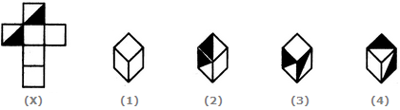
VISUAL REASONING
DICE (EXERCISE-A)
Q 2. Choose the box that is similar to the box formed from the given sheet of paper (X).
A. 1 and 4 only B. 3 and 4 only
C.1 and 2 only D. 2 and 3 only

Slide 5
VISUAL REASONING
DICE (EXERCISE-A)
Q 2. Choose the box that is similar to the box formed from the given sheet of paper (X).
A. 1 and 4 only B. 3 and 4 only
C.1 and 2 only D. 2 and 3 only

Slide 6

VISUAL REASONING
DICE (EXERCISE-A)
Q 3. How many dots lie opposite to the face having three dots, when the given figure is folded to form a cube?
A.2 B.4 C.5 D.6

Slide 7
VISUAL REASONING
DICE (EXERCISE-A)
Q 3. How many dots lie opposite to the face having three dots, when the given figure is folded to form a cube?
A.2 B.4 C.5 D.6

Slide 8
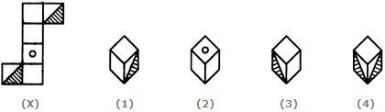
VISUAL REASONING
DICE (EXERCISE-A)
Q 4. Choose the box that is similar to the box formed from the given sheet of paper (X).
A.C 1 and 3 only B. 1 and 4 only
C. 2 and 4 only D. 3 and 4 only

Slide 9
VISUAL REASONING
DICE (EXERCISE-A)
Q 4. Choose the box that is similar to the box formed from the given sheet of paper (X).
A.1 and 3 only B. 1 and 4 only
C. 2 and 4 only D. 3 and 4 only

Slide 10
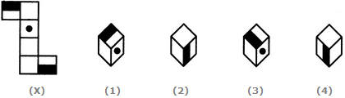
VISUAL REASONING
DICE (EXERCISE-A)
Q 5. Choose the box that is similar to the box formed from the given sheet of paper (X).
A. 1 and 2 only B. 2 and 3 only
C. 2 and 4 only D. 1, 2, 3 and 4

Slide 11
VISUAL REASONING
DICE (EXERCISE-A)
Q 5. Choose the box that is similar to the box formed from the given sheet of paper (X).
A. 1 and 2 only B. 2 and 3 only
C. 2 and 4 only D. 1, 2, 3 and 4

Slide 12
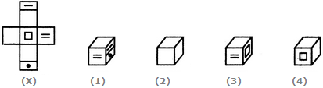
VISUAL REASONING
DICE (EXERCISE-A)
Q 6. Choose the box that is similar to the box formed from the given sheet of paper (X).
A. 1 only B. 1 and 3 only
C. 1, 3 and 4 only D. 1, 2, 3 and 4

Slide 13
VISUAL REASONING
DICE (EXERCISE-A)
Q 6. Choose the box that is similar to the box formed from the given sheet of paper (X).
A. 1 only B. 1 and 3 only
C. 1, 3 and 4 only D. 1, 2, 3 and 4

Slide 14
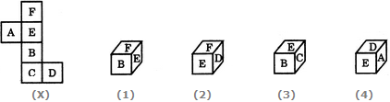
VISUAL REASONING
DICE (EXERCISE-A)
Q 7. Choose the box that is similar to the box formed from the given sheet of paper (X).
A.1 only B.2 only
C.1 and 3 only D.1, 2, 3 and 4 only

Slide 15
VISUAL REASONING
DICE (EXERCISE-A)
Q 7. Choose the box that is similar to the box formed from the given sheet of paper (X).
A.1 only B.2 only
C.1 and 3 only D.1, 2, 3 and 4 only

Slide 16
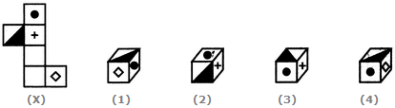
VISUAL REASONING
DICE (EXERCISE-A)
Q 8. Choose the box that is similar to the box formed from the given sheet of paper (X).
A.1 only B.2 only C.3 only D.4 only

Slide 17
VISUAL REASONING
DICE (EXERCISE-A)
Q 8. Choose the box that is similar to the box formed from the given sheet of paper (X).
A.1 only B.2 only C.3 only D.4 only

Slide 18
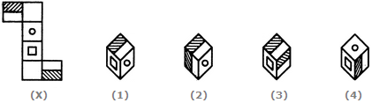
VISUAL REASONING
DICE (EXERCISE-A)
Q 9. Choose the box that is similar to the box formed from the given sheet of paper (X).
A.1 only B.2 only C.3 only D.4 only

Slide 19
VISUAL REASONING
DICE (EXERCISE-A)
Q 9. Choose the box that is similar to the box formed from the given sheet of paper (X).
A.1 only B.2 only C.3 only D.4 only

Slide 20
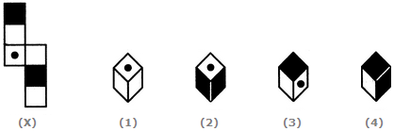
VISUAL REASONING
DICE (EXERCISE-A)
Q 10. Choose the box that is similar to the box formed from the given sheet of paper (X).
A.2 and 3 only B.1, 3 and 4 only
C.2 and 4 only D.1 and 4 only

Slide 21
VISUAL REASONING
DICE (EXERCISE-A)
Q 10. Choose the box that is similar to the box formed from the given sheet of paper (X).
A.2 and 3 only B.1, 3 and 4 only
C.2 and 4 only D.1 and 4 only

Slide 22
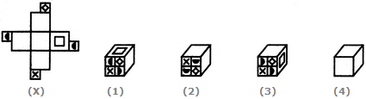
VISUAL REASONING
DICE (EXERCISE-A)
Q 11. Choose the box that is similar to the box formed from the given sheet of paper (X).
A.1, 2 and 3 only B.2 and 3 only
C.1, 3 and 4 only D.2, 3 and 4 only

Slide 23
VISUAL REASONING
DICE (EXERCISE-A)
Q 11. Choose the box that is similar to the box formed from the given sheet of paper (X).
A.1, 2 and 3 only B.2 and 3 only
C.1, 3 and 4 only D.2, 3 and 4 only

Slide 24
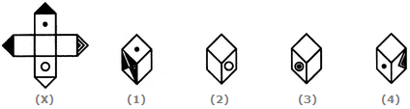
VISUAL REASONING
DICE (EXERCISE-A)
Q 12. Choose the box that is similar to the box formed from the given sheet of paper (X).
A.1 and 2 only B.1, 2 and 3 only
C.1 and 3 only D.1, 2, 3 and 4

Slide 25
VISUAL REASONING
DICE (EXERCISE-A)
Q 12. Choose the box that is similar to the box formed from the given sheet of paper (X).
A.1 and 2 only B.1, 2 and 3 only
C.1 and 3 only D.1, 2, 3 and 4

Slide 26
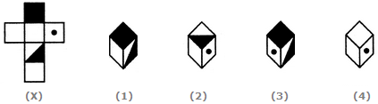
VISUAL REASONING
DICE (EXERCISE-A)
Q 13. Choose the box that is similar to the box formed from the given sheet of paper (X).
A.1 and 3 only B.2, 3 and 4 only C.2 only D.3 and 4 only

Slide 27
VISUAL REASONING
DICE (EXERCISE-A)
Q 13. Choose the box that is similar to the box formed from the given sheet of paper (X).
A.1 and 3 only B.2, 3 and 4 only C.2 only D.3 and 4 only

Slide 28
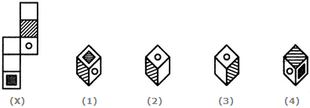
VISUAL REASONING
DICE (EXERCISE-A)
Q 14. Choose the box that is similar to the box formed from the given sheet of paper (X).
A.1 and 2 only B.1, 2 and 4 only
C.1 and 4 only D.1, 2 and 3 only

Slide 29
VISUAL REASONING
DICE (EXERCISE-A)
Q 14. Choose the box that is similar to the box formed from the given sheet of paper (X).
A.1 and 2 only B.1, 2 and 4 only
C.1 and 4 only D.1, 2 and 3 only

Slide 30

VISUAL REASONING
DICE (EXERCISE-A)
Q 15. Choose the box that is similar to the box formed from the given sheet of paper (X).
A.1 and 2 only B.2, 3 and 4 only
C.4 only D.3 and 4 only

Slide 31
VISUAL REASONING
DICE (EXERCISE-A)
Q 15. Choose the box that is similar to the box formed from the given sheet of paper (X).
A.1 and 2 only B.2, 3 and 4 only
C.4 only D.3 and 4 only

Slide 32
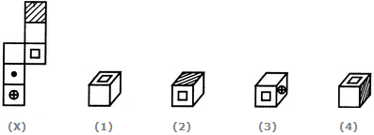
VISUAL REASONING
DICE (EXERCISE-A)
Q 16. Choose the box that is similar to the box formed from the given sheet of paper (X).
A.1 only B.2 and 3 only
C.1 and 3 only D.1, 2 and 4 only

Slide 33
VISUAL REASONING
DICE (EXERCISE-A)
Q 16. Choose the box that is similar to the box formed from the given sheet of paper (X).
A.1 only B.2 and 3 only
C.1 and 3 only D.1, 2 and 4 only

Slide 34
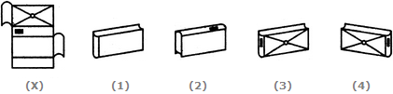
VISUAL REASONING
DICE (EXERCISE-A)
Q 17. Which of the following finished patterns can be obtained from the piece of cardboard (X) shown below?
A.1 B.2 C.3 D.4

Slide 35
VISUAL REASONING
DICE (EXERCISE-A)
Q 17. Which of the following finished patterns can be obtained from the piece of cardboard (X) shown below?
A.1 B.2 C.3 D.4

Slide 36

VISUAL REASONING
DICE (EXERCISE-A)
Q 18. Choose the box that is similar to the box formed from the given sheet of paper (X).
A.1 and 3 only B.2 and 4 only
C.3 and 4 only D.1 and 4 only

Slide 37
VISUAL REASONING
DICE (EXERCISE-A)
Q 18. Choose the box that is similar to the box formed from the given sheet of paper (X).
A.1 and 3 only B.2 and 4 only
C.3 and 4 only D.1 and 4 only

Slide 38
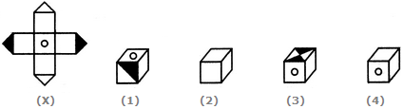
VISUAL REASONING
DICE (EXERCISE-A)
Q 19. Choose the box that is similar to the box formed from the given sheet of paper (X).
A.1 only B.2 only
C.3 only D.4 only

Slide 39
VISUAL REASONING
DICE (EXERCISE-A)
Q 19. Choose the box that is similar to the box formed from the given sheet of paper (X).
A.1 only B.2 only
C.3 only D.4 only

Slide 40

VISUAL REASONING
DICE (EXERCISE-A)
Q 20. When the following figure is folded to form a cube, how many dots lie opposite the face bearing five dots?
A.1 B.2 C.3 D.4

Slide 41
VISUAL REASONING
DICE (EXERCISE-A)
Q 20. When the following figure is folded to form a cube, how many dots lie opposite the face bearing five dots?
A.1 B.2 C.3 D.4

Slide 42
VISUAL REASONING
DICE (EXERCISE-A)
Q 1.

